Slide 1
Computer Vision
Part 2: Image Captioning
ADF – Start 08:30

Slide 2

Agenda
Part 1: Recurrent Neural Network
Part 2: Image Captioning
Computer Vision

Slide 3
Image Captioning
Computer Vision

Slide 4
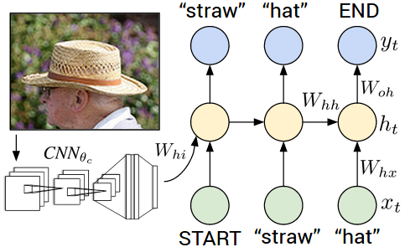
Image Captioning
Explain Images with Multimodal Recurrent Neural Networks, Mao et al.
Deep Visual-Semantic Alignments for Generating Image Descriptions, Karpathy and Fei-Fei
Show and Tell: A Neural Image Caption Generator, Vinyals et al.
Long-term Recurrent Convolutional Networks for Visual Recognition and Description, Donahue et al.
Learning a Recurrent Visual Representation for Image Caption Generation, Chen and Zitnick
Computer Vision

Slide 5
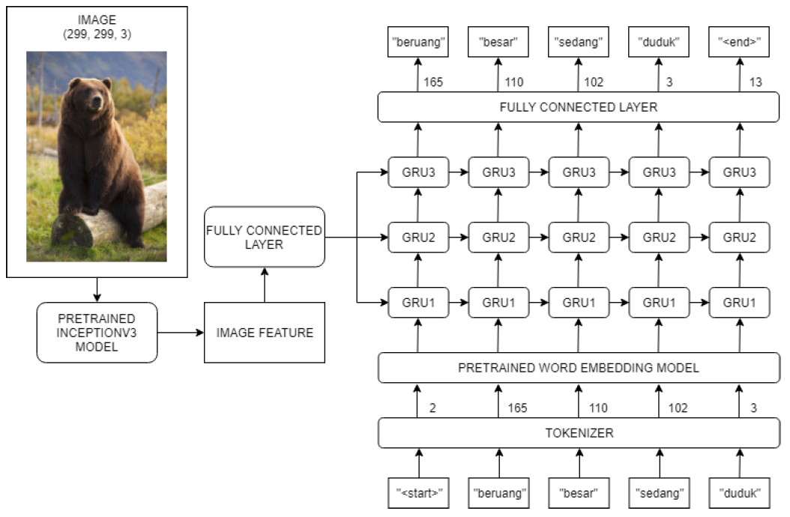
Image Captioning
Recurrent Neural Network
Convolutional Neural Network
Generating Image Description on Indonesian Language using Convolutional Neural Network and Gated Recurrent Unit, Aditya Alif et al
Computer Vision

Slide 6
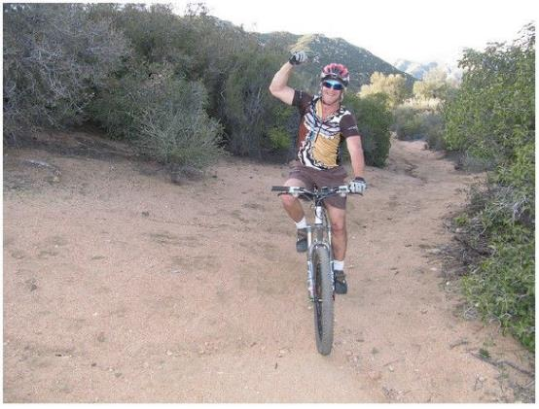
Image Sentence Datasets
Microsoft COCO
[Tsung-Yi Lin et al. 2014]
mscoco.org
currently:
~120K images
~5 sentences each
A man riding a bike on a dirt path through a forest.
Bicyclist raises his fist as he rides on desert dirt trail.
This dirt bike rider is smiling and raising his fist in triumph,
A man riding a bicycle while pumping his fist in the air.
A mountain biker pumps his fist in celebration
Computer Vision

Slide 7

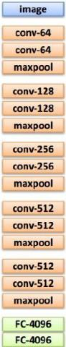
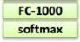
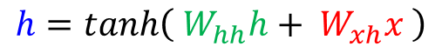

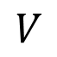
test image
y0
y1
y2
<END> token ➔ finish.
before:
$$W_{ih}$$
h0
h1
h2
$$h=tanh\left( W_{hh}h+ W_{xh}x \right)$$
now:
$$h=tanh\left( W_{hh}h+ W_{xh}x+W_{ih}v \right)$$
x0
<start>
straw
hat
sample!
$$V$$
<START>
Computer Vision

Slide 8
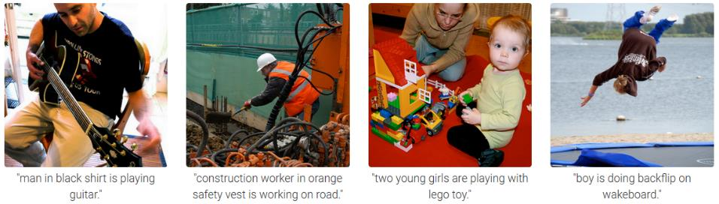
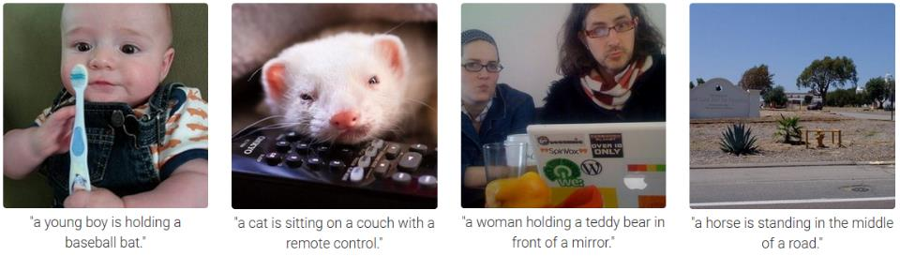
Computer Vision

Slide 9
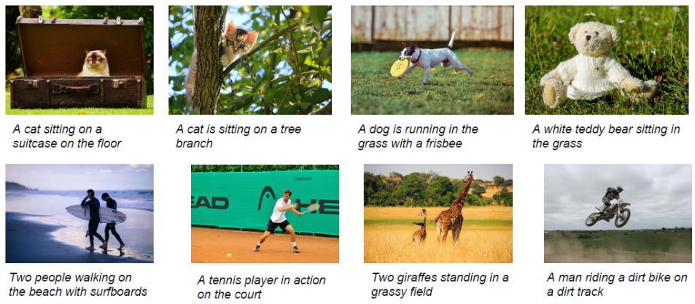
Better Results
Computer Vision

Slide 10
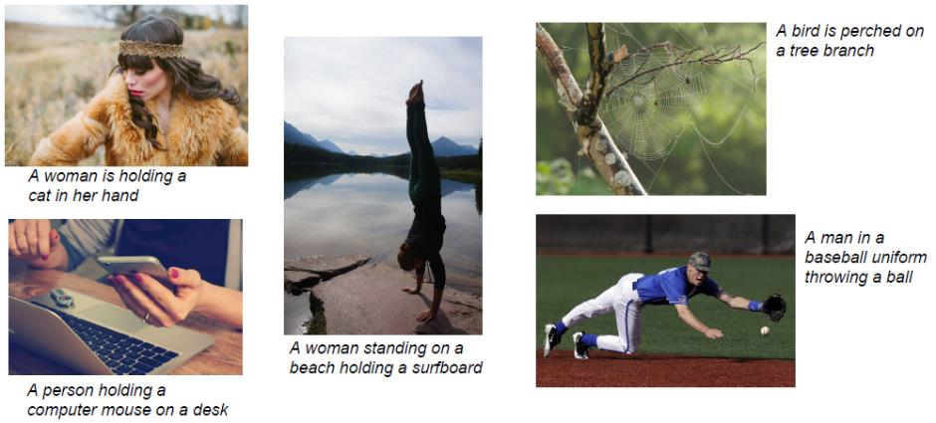
Failed Results on Very Different Data
Computer Vision

Slide 11
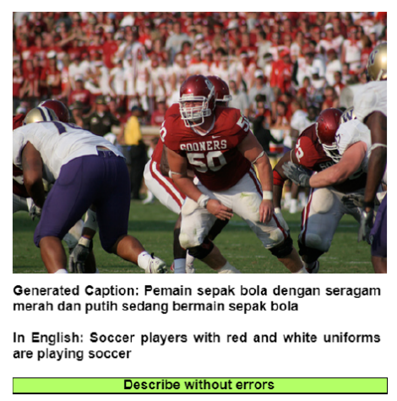
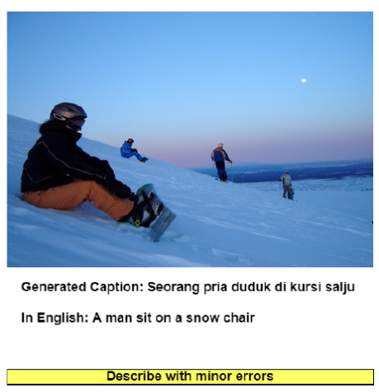
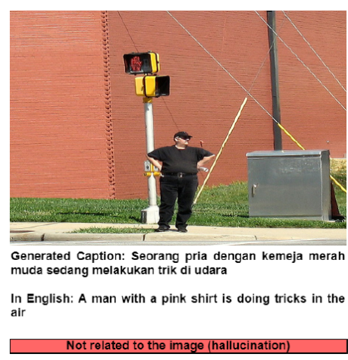
Indonesian Captioning
Generating Image Description on Indonesian Language using Convolutional Neural Network and Gated Recurrent Unit, Aditya Alif et al, 2019
Computer Vision

Slide 12
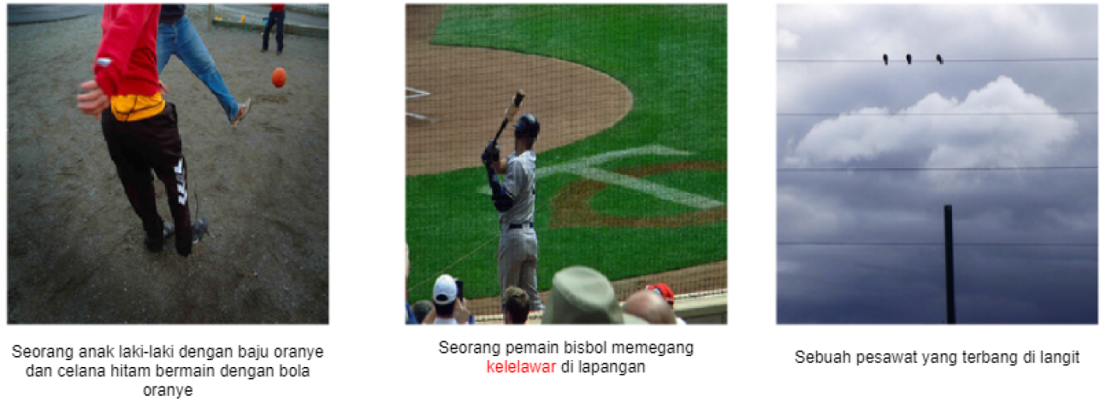
Indonesian Captioning
Adaptive Attention Generation for Indonesian Image Captioning, Made et.al, 2020
Computer Vision

Slide 13
Advanced Architectures
Computer Vision

Slide 14
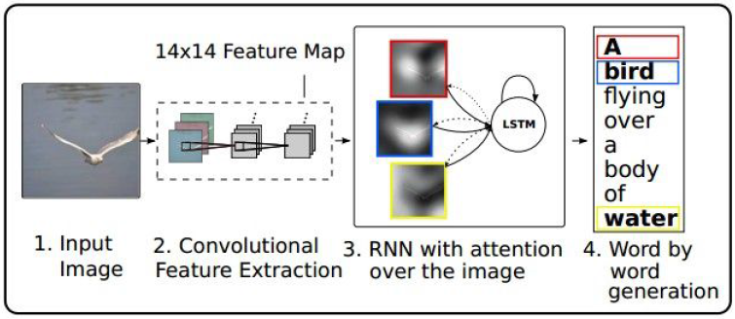
Image Captioning with Attention
RNN focuses its attention at a different spatial location of the images when generating each word of the sentence
[Show Attend and Tell, Xu et al., 2015]
Computer Vision
Notes:
Roll the RNN back to the image, lookup

Slide 15
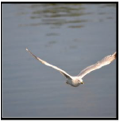
Image Captioning with Attention
Distribution over L location
Distribution over vocab
Weighted combination of features
a1
a2
d1
h0
h1
h2
. . .
CNN
Features:
L x D
Image:
H x W x 3
z1
Weighted features:
D
y1
z2
y2
1st
word
Xu et al, “Show, Attend and Tell: Neural Image Caption Generation with Visual Attention”, ICML 2015
Computer Vision

Slide 16
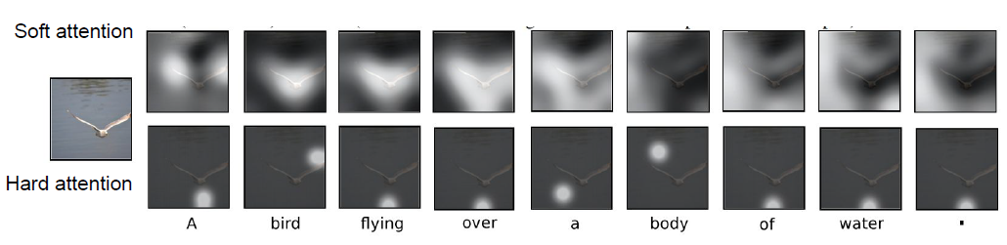
Image Captioning with Attention
[Show Attend and Tell, Xu et al., 2015]
Computer Vision
Notes:
Roll the RNN back to the image, lookup

Slide 17
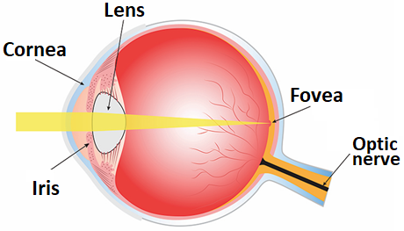
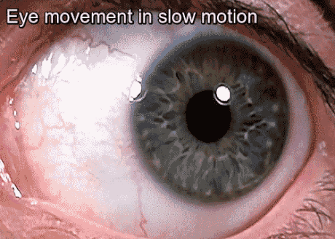
Image Captioning with Attention
The fovea is a tiny region of the retina that can see with high acuity
saccade
Computer Vision
Notes:
Roll the RNN back to the image, lookup

Slide 18
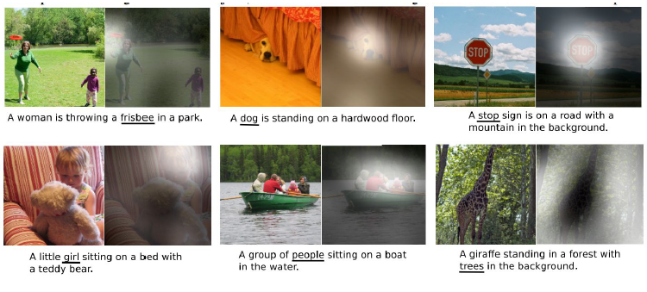
Image Captioning with Attention
[Show Attend and Tell, Xu et al., 2015]
Computer Vision
Notes:
Roll the RNN back to the image, lookup

Slide 19
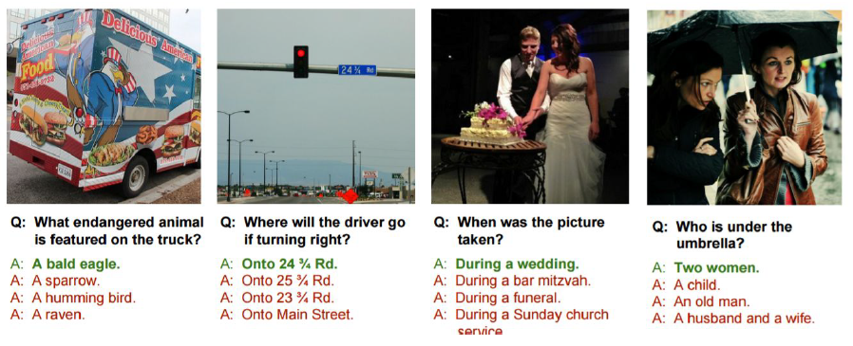
Visual Question Answering
Agrawal et al, “VQA: Visual Question Answering”, ICCV 2015
Zhu et al, “Visual 7W: Grounded Question Answering in Images”, CVPR 2016
Computer Vision
Notes:
Roll the RNN back to the image, lookup

Slide 20
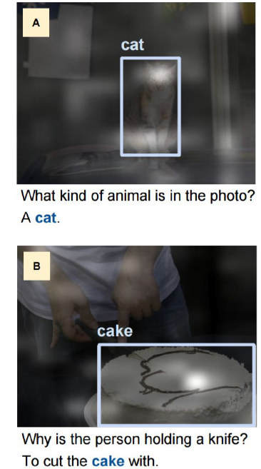
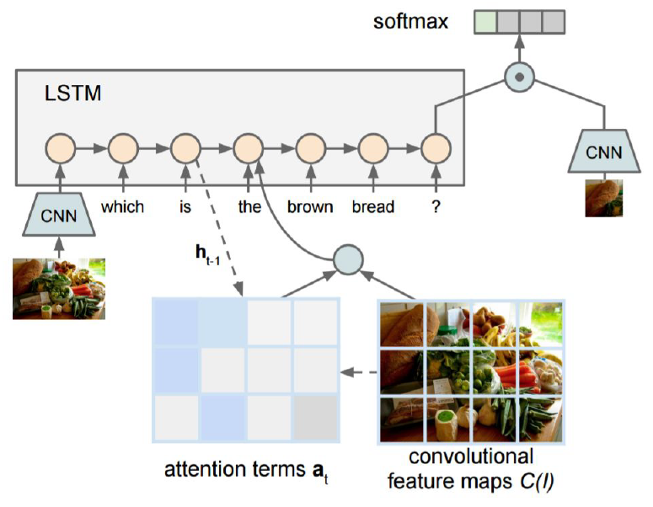
Visual Question Answering
Zhu et al, “Visual 7W: Grounded Question Answering in Images”, CVPR 2016
Computer Vision
Notes:
Roll the RNN back to the image, lookup

Slide 21
“Attention” Papers
“Show, attend, and tell” (Xu et al, ICML 2015)
Look at image, attend to image regions, produce question
“Ask, attend, and answer” (Xu and Saenko, ECCV 2016)
“Show, ask, attend, and answer” (Kazemi and Elqursh, 2017)
Read text of question, attend to image regions, produce answer
“Listen, attend, and spell” (Chan et al, ICASSP 2016)
Process raw audio, attend to audio regions while producing text
“Listen, attend, and walk” (Mei et al, AAAI 2016)
Process text, attend to text regions, output navigation commands
“Show, attend, and interact” (Qureshi et al, ICRA 2017)
Process image, attend to image regions, output robot control commands
“Show, attend, and read” (Li et al, AAAI 2019)
Process image, attend to image regions, output text
Etc.
Computer Vision
Notes:
Roll the RNN back to the image, lookup

Slide 22

Question?
Computer Vision

Slide 23

Next Agenda
???
Attention and Transformers ?
Video Processing ?
Case studies ?
Computer Vision

Slide 24
References
Fei-Fei Li, Justin J, Serena Y - Stanford CS231n 2018 Course
Justin Johnson– EECS498 Lectures, University of Michigan
Yogesh Singh Rawat – CAP5415 Lectures, University of Central Florida
Grauman, K. and Leibe, B. 2011. Visual Object Recognition. Synthesis Lectures Artif. Intell. Mach. Learn. 5, 1 181
Computer Vision

